Slide 1
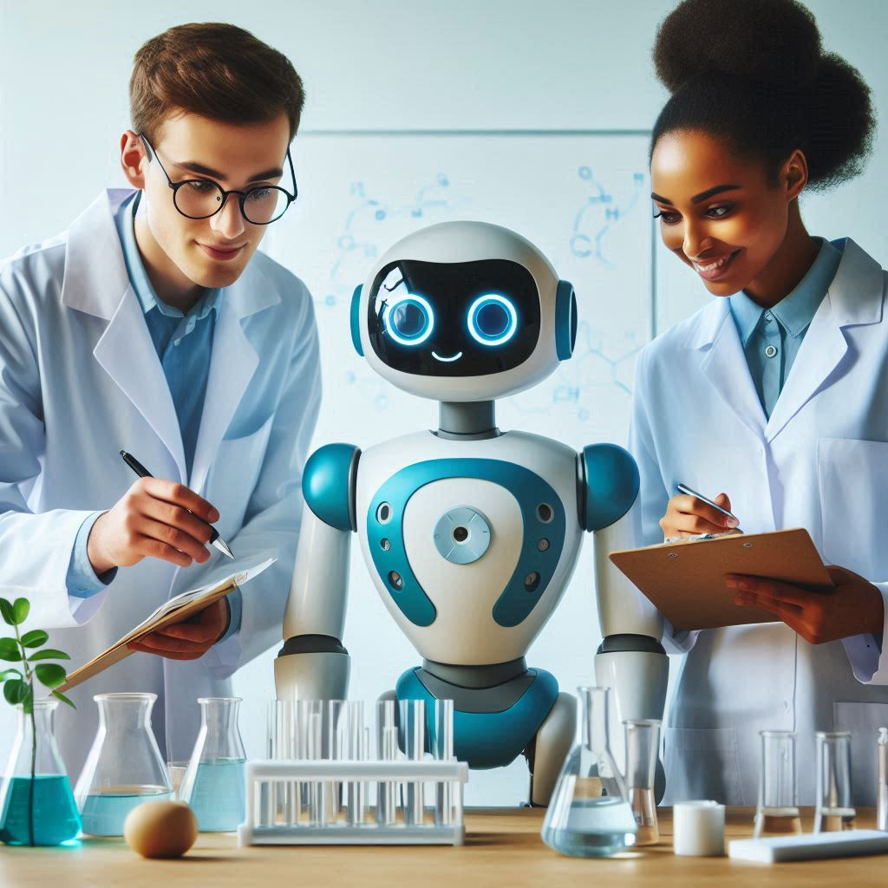
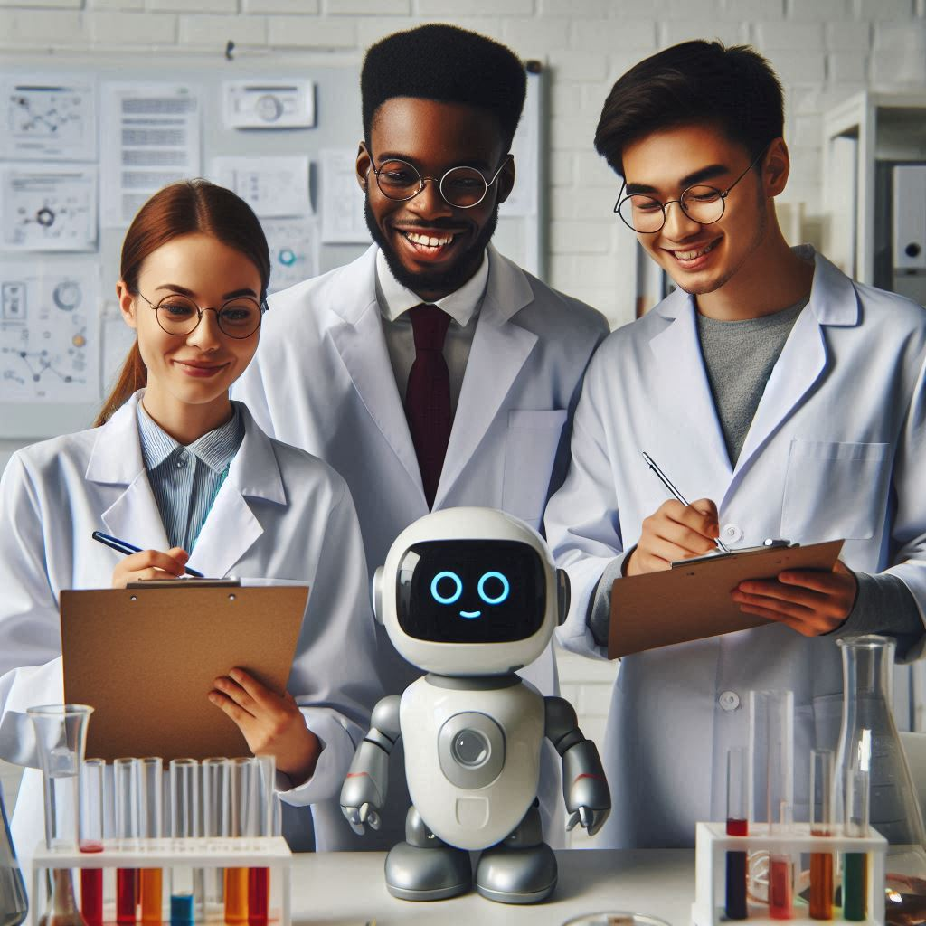
Generative AI and Business

Slide 2
Generative AI and Business

Slide 3
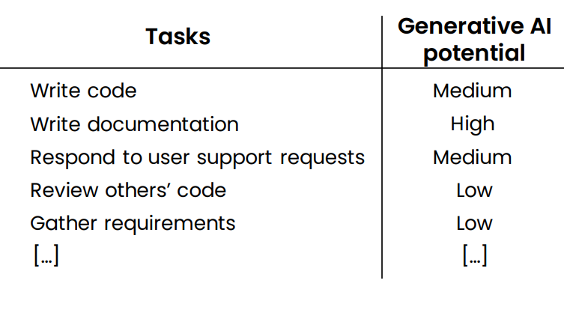
Computer programmer

Slide 4
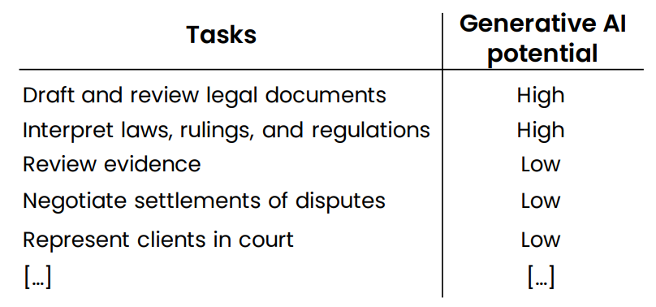
Lawyer

Slide 5
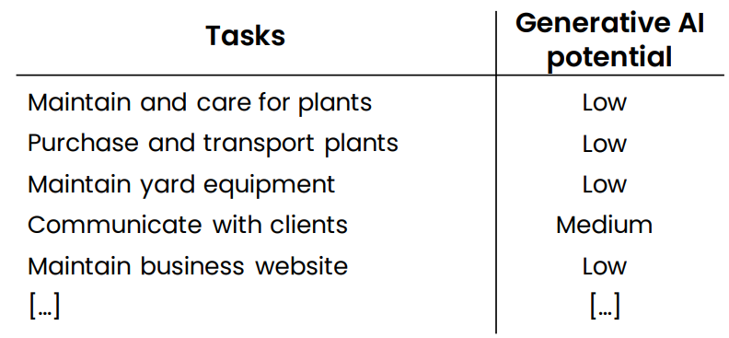
Landscaper

Slide 6
New workflows and new Opportunities

Slide 7
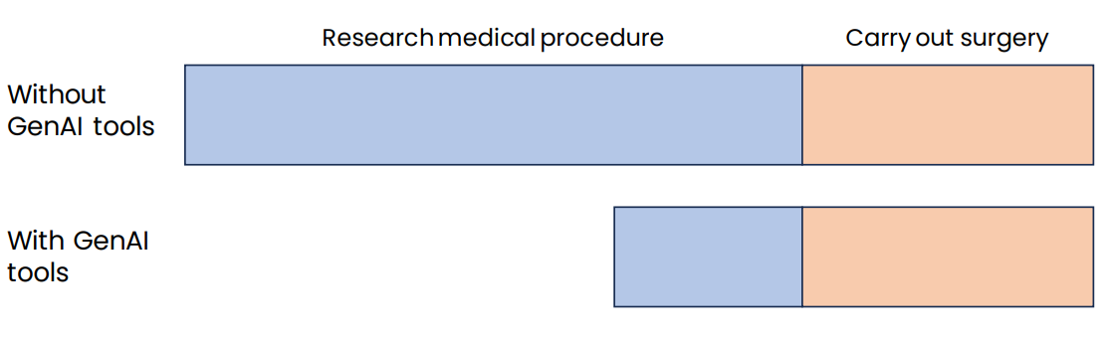
Example 1: Surgeon

Slide 8
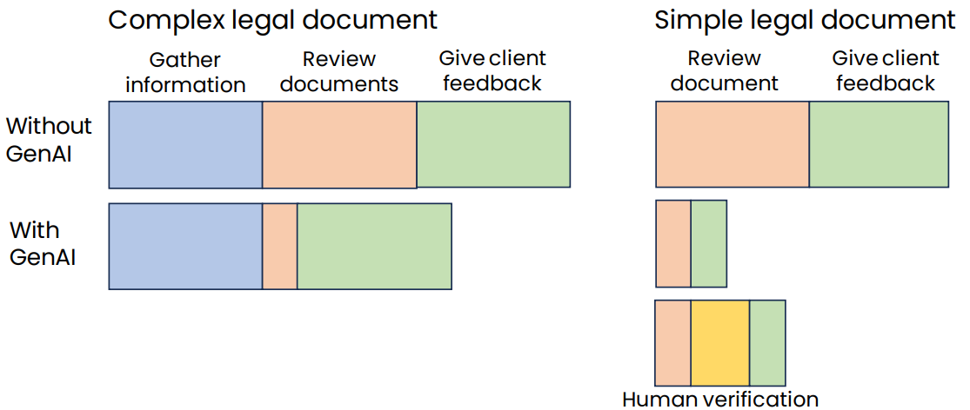
Example 2: Legal documentation review

Slide 9
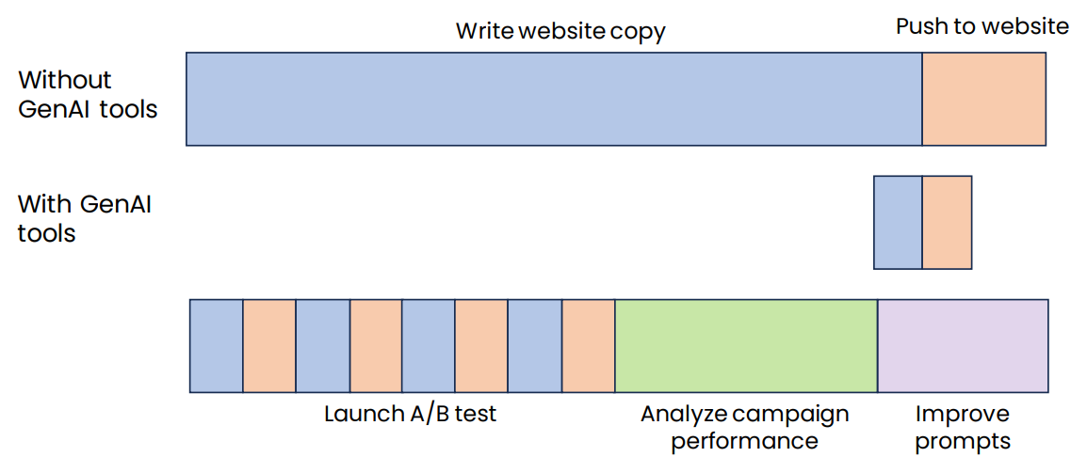
Example 3: Marketing automation

Slide 10
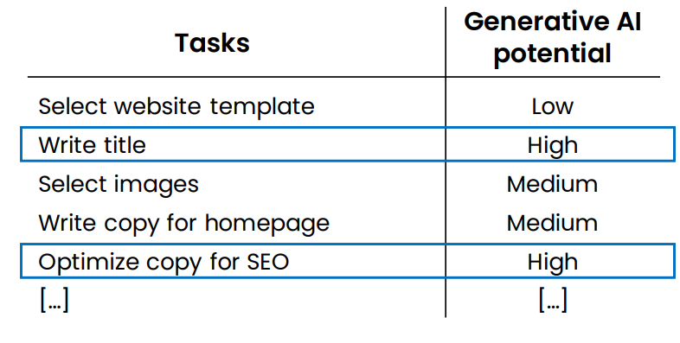
Example: Helping customers build websites

Slide 11
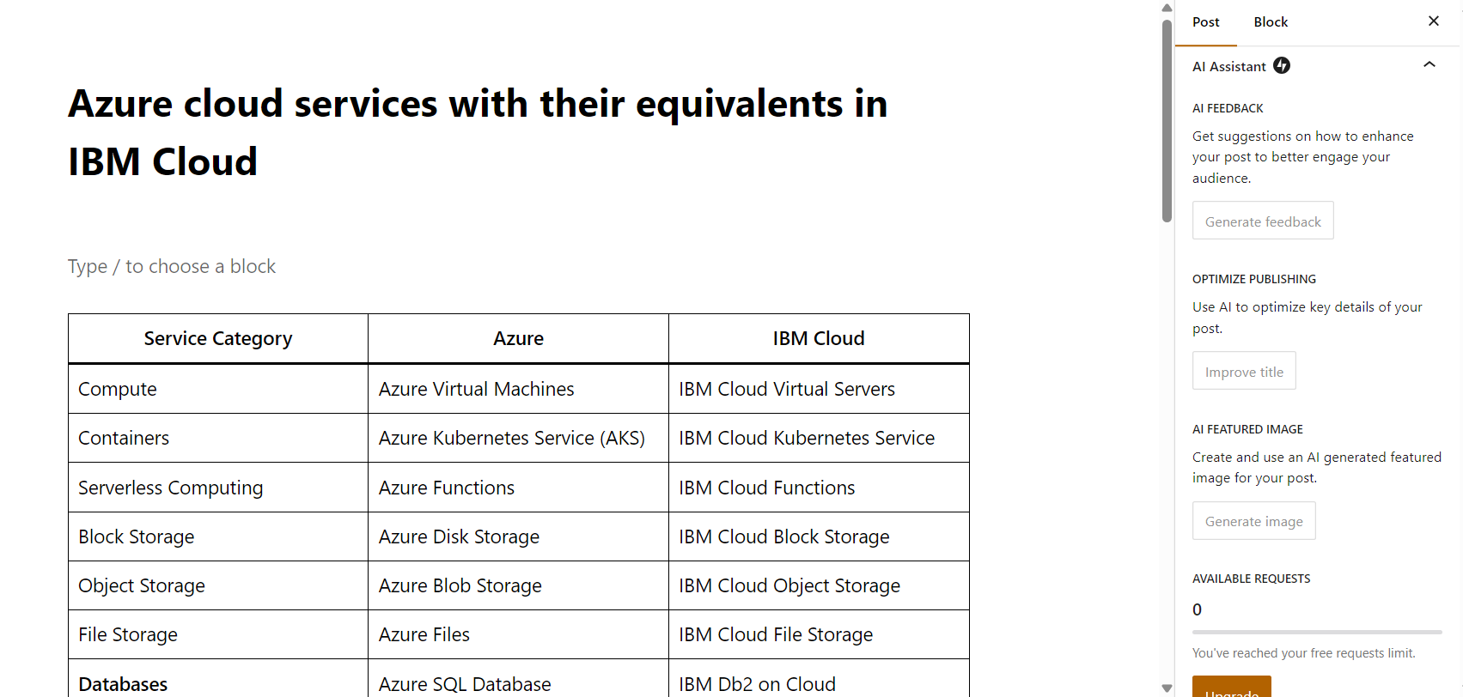
Wordpress AI Assitant

Slide 12
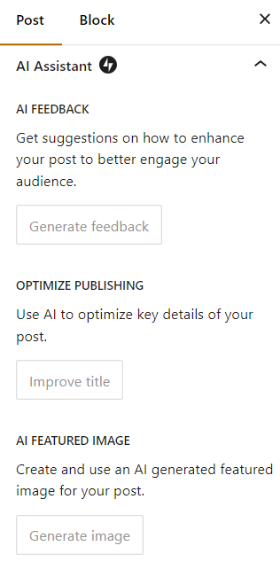
Wordpress AI Assitant

Slide 13
Contents creation timeline
🌐 Web 1.0 (1990s) 🌐 ➡️ Static pages, one-way streets for information.
📸 Web 2.0 (Early 2000s) 📸 ➡️ User-generated content via blogs and forums.
📱 The Rise of Social Media (Mid-2000s) 📱 ➡️ Content creation exploded, share & influence, "Viral" became a buzzword.
📱 Mobile Era (2010s) 📱 ➡️ Content consumption habits changed, visual storytelling, short content.
🤖 AI and Automation (Present) 🤖 ➡️ Today's helpers. Today, AI assists content creators with everything.

Slide 14
AI Agents

Slide 15


Q&A

